Slide 1
Therac-25 Case
Computingcases.org
Safeware

Slide 2
In this case…
you will practice decision-making from the participatory standpoint
learn how to make decisions in the face of uncertainty
Uncertain whether the patient complaints indicate radiation overdoes
Uncertain, if there is overdose, whether the cause if machine failure or operator error or something else.
these decisions involve risk (probability of harm) and you will learn about ethical issues associated with safety and risk

Slide 3
What you know…
You work at the East Texas Cancer Center in Tyler, Texas as a physicist who “maintains and checks the machine regularly.” (Huff 2005)
Patient complains of “a bright flash of light, heard a frying, buzzing sound, and felt a thump and heat like an electric shock.” (Huff 2005)
This indicates radiation overdose but AECL engineers say, “the Therac-25 was unable to overdose a patient and also… that AECL had no knowledge of any overexposure accidents by [other] Therac-25 machines [in use].”
A few days after the unit was put back into operation, another patient complained that his face felt like it was on fire (Huff 2005)

Slide 4
Something is clearly wrong. But you have no idea what it is. You would like to investigate further to see whether…
the patients’ complaints indicate radiation overdoses
the overdoses were caused by a defect in the Therac-25 machine
the overdoses were caused by operator error
Constraints
AECL engineers state that there is no problem with the machine, and they have received no complaints about the other machines that are in operation
ETCC administrators have told you that you cannot interview the two patients making the complaints
Your job is on the line

Slide 5
Operator Perspective
The newest machine has replaced hardware safety controls with software controls.
But operators find this deskilling objectionable
Operator activates machine from another room. But audio and video systems do not work yet they must continue to treat patients
Software controls shorten time required for each treatment.
Operators feel pressured to treat more patients
Error messages provided by Therac-25 monitor are not helpful to operators
Machine pauses treatment but does not indicate reason why

Slide 6
Decision Point
You supervise the radiation unit at your hospital. A patient has complained that he has received a radiation overdose during a treatment session caused by the malfunctioning of the Therac-25 unit.
Construct an argument for or against the continued operation of the therac-25 units while investigating complaints.
Integrate ethical, social and financial considerations into your argument. How does the informed consent of the patients enter into this situation? What role do safety and risk play?

Slide 7
Cast of Characters
Manufacturers
Interest: reputation, financial gain
Role: Design, tested, prepared for approval, manufactured, sold Therac units
Atomic Energy of Canada Limited (AECL)
Quality Assurance Manager
Home office engineer
Local (Tyler) engineer
Software Programmer (licensed?)
CGR (France)
Dropped out after production of 20 unit in 1981

Slide 8
Cast of Characters
Regulatory Agencies
FDA (Food and Drug Administration)
CRPB (Canadian Radiation Protection Bureau)
Gordon Symonds head of advanced X-ray Systems
Interest (Maintaining integrity in public eye)
Role (Regulate new products for safety)

Slide 9
Cast of Characters
Hospitals
Kennestone facility in Marietta, GA
(ETCC) East Texas Cancer Center, Tyler, TX (2)
Hamilton, Ontario Hospital
Yakima Valley Memorial Hospital (2)
Interest
Maintain good reputation; promote patient values of health and well being; maintain financial solvency
Role
Provide treatment options for patients; staff hospitals with doctors and nurses; equip with adequate medical technology

Slide 10
Cast of Characters
User Groups (Operators)
Put out user group newsletters
Hospital Physicists
Tim Still (Physicist at Kennestone)
Eight problems with Therac-25
Poor screen-refresh subroutines
“Is programming safety relying too much on the software interlock routines?” *
Fritz Hager (Physicist at ETCC)
Consulted with AECL on suspected overdoses
Helped operator reconstruct sequence that produced race condition
Interest: job, reputation, professional dignity and integrity
Role: maintain treatment machines; supervise operators; respond to patient complaints
* Leveson, p. 539

Slide 11
Cast of Characters
AECL engineers
Designed and tested new units
Not responsible for maintenance (This was performed by hospital physicists)
Sent to investigate complaints about units
Quality Assurance Manager
Software Programmer
Are they responsible for collecting information on the use-history of the machines they designed?

Slide 12
Cast of Characters
Cancer Patients
Receive radiation therapy
Shallow tissue is treated with accelerated electrons
Deeper tissue is treated with X-ray photons
Interest
Health and Well Being
Informed Consent
Conditions?

Slide 13
Role Responsibility
Obligations that following from the social or professional role one occupies
Who is responsible for testing the software and hardware of the Therac-25 unit? (Standards of due or reasonable care?)
Who is responsible for monitoring the operating history of these machines and collecting and coordinating possible complaints?
(Designers? Regulatory Agencies?)
Who is responsible for regulating these machines and other devices?
Who is responsible for teaching operators how to use machines and maintenance?
Expensive AECL training programs. Limits of operator manuals
How can machines be operated in an efficient way without sacrificing patient health, safety, and well being?

Slide 14
The Machine: Therac-25
Medical linear accelerators (linacs)
Earlier Models: Therac-6 and 20
Therac-25
First prototype in 1976
Marketed in late 1982

Slide 15
What it does
Leveson: “Medical linear accelerators accelerate electrons to create high-energy beams that can destroy tumors with minimal impact on surrounding healthy tissue” 515
Shallow tissue is treated with accelerated electrons
“the scanning magnets [were] placed in the way of the beam” “The spread of the beam (and thus its power) could be controlled by the magnetic fields generated by these magnets” (Huff/Brown)
Deeper tissue is treated with X-ray photons
Huff: “The X-ray beam is then “flattened” by a device below the foil, and the ex-ray beam of an appropriate intensity is then directed to the patient.” (requires foil and flattener)
Beams kill (or retard the growth of) the cancerous tissue

Slide 16
Therac-25 Hardware Features (Leveson 516-517)
Double Pass Electron Accelerator
“needs much less space to develop comparable energy levels”
“folds the long physical mechanism required to accelerate the electrons”
Dual Mode
Turntable allows aligning equipment/accessories in different ways
One alignment produces X-rays
Another alignment produces electrons
Third alignment (field light position) is used for targeting machine
More computer control
Speeds up alignment of turntable (equipment to accessories)
Speeds up data entry (patient/dose/data)
More patients/more time per patient

Slide 17
Therac-25: Hardware controls to software controls
Machine functions that software had to monitor
Monitoring the machine status
Placement of turntable
Strength and shape of beam
Operation of bending and scanning magnets
Setting the machine up for the specified treatment
Turning the beam on
Turning the beam off (after treatment, on operator command, or if a malfunction is detected)
(Huff, 2005)

Slide 18
Two features of Therac-25 to save time
Retry Facility
Controls pause treatment if there is a minor discrepancy between machine setting and dose entered
Up to 5 retries are allowed before machine completely shuts itself down (in event of small discrepancies)
Shut Down Facility
If there is a major discrepancy, then the machine shuts itself down
To restart, the operator must reenter all the treatment parameters
Some operators used jumper cables to bypass this shutdown feature

Slide 19
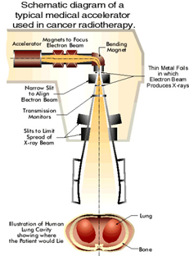

Slide 20
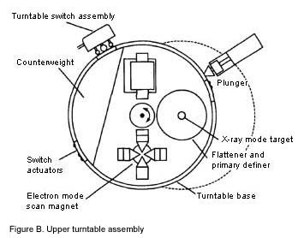

Slide 21
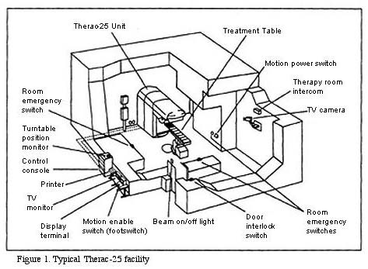

Slide 22
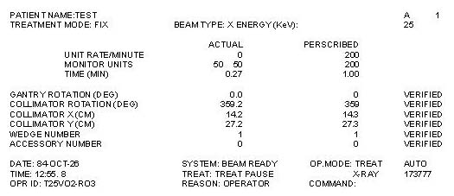

Slide 23
Software Components
Stored data
Calibration parameters for accelerator setup
Patient treatment data
Scheduler
Controls sequencing of all noninterrupt events and coordinates all concurrent processes
Set of critical and noncritical tasks
Critical: treatment monitor, servo task (gun emission, dose rate, machine motions), housekeeper task (system status, interlocks, displays messages)
Noncritical: checksum, treatment console keyboard processor, treatment console screen processor, service keyboard processor, snapshot, hand control processor, calibration processor
Interrupt services

Slide 24
Programming Issues
Real-time software
“interacts with the world on the world’s schedule, not the software’s.”
Software is required to monitor several activities simultaneously in real time
Interaction with operator
Monitoring input and editing changes from an operator
Updating the screen to show the current status of machine
Printing in response to an operator commands

Slide 25
FDA Pre-Market Approval
Class I
“general controls provide reasonable reassurance of safety and effectiveness””
Class II
“require performance standards in addition to general controls”
Class III
Undergo premarket approval as well as comply with general controls
Used earlier Therac models to show “pre-market equivalence”
But this covered over three key changes:
removal of hardware safety controls,
delegation of safety from hardware to software,
No testing of additional programming for Therac-25 layered on programming for 6 and 20 units

Slide 26
FDA couldn’t recall defective products
Ask for information from a manufacturer
Require a report from the manufacturer
Declare a product defective and require a corrective action plan (CAP)
Publicly recommend that routine use of the system on patients be discontinued
Publicly recommend a recall

Slide 27
Testing the Machine for Safety
1983—Fault Tree Analysis
Specify hazards
Specify causal sequences to produce hazards
Software not included
Software added onto existing software used in prior units
Since these did not fail, assumed software was not subject to failure

Slide 28
Interview with Therac Unit Operator
Did not consider possibility of software bugs
Appreciated added speed of operation (more patients, more time with patient)
Unclear error messages
No industry-wide standards on whether, how, and how many times operators could override error messages

Slide 29
Interview (Cont.)
Lack of industry-wide certification of radiation unit operators
ARRT provides test and licensing procedure
But many hospitals hire non-ARRT certified operators
Operators pressured by many hospital administrators to push through a large number of patients
Manufacturers charge large fees for…
Operator training sessions
Software upgrades
Machine maintenance contracts

Slide 30
Chronology
Modified from Computing Cases
Chronology to the point where Hager has to make a decision.
Chronology picked up at end of presentation.

Slide 31
Date | Event
Early 1970’s | AECL and a French Company (CGR) collaborate to build Medical Linear Accelerators (linacs), Therac 6 and 20.
1976 | AECL develops the revolutionary “double pass” accelerator the basis of theTherac-25 model
1981 | AECL and CGR end working relationship.
March 1983 | AECL performs a safety analysis of Therac-25, excluding analysis of software. (Software assumed safer than hardware so safety functions delegated to software and hardware controls removed)
July 29, 1983 | Canadian Consulate General announces the introduction of the new Therac-25 machine
December 1984 | Marietta Georgia, Kennestone Reginal Oncology Center implements newT-25 unit

Slide 32
Date | Event
June 3, 1985 | Marietta Georgia, Kennestone—Possible patient overdosed. Tim Still, hospital physicist calls AECL (Is overdose possible? AECL informs that it is not)
July 26, 1985 | Hamilton, Ontario--possible patient overdose. AECL is informed and sends service engineer to investigate. No coordination between Georgia and Ontario
Nov 3, 1985 | Hamilton patient dies of cancer. But burn received in treatment would have eventually required hip replacement.
Nov 6, 1985 | Letter from CRPB to AECL requesting hardware interlocks and software changes. Letter also requested automatic treatment termination in event of malfunction with no option to proceed with single keystroke.
Nov 18, 1985 | Kennestone (possible) overdose victim files suit against AECL and Kennestone. AECL informed officially of lawsuit
Dec 1985 | Yakima Hospital (Washington) patient develops erythema on hip after one of treatments

Slide 33
Date | Event
Jan 31, 1986 | Yakima staff sends letter to AECL and speaks with AECL technical support advisor. Still no coordination between different hospitals
Feb 24, 1986 | AECL technical support supervisor sends written response to Yakima claiming that T-25 unit not responsible for patient injuries.
March 21-22, 1986 | Patient at East Texas Cancer Center (Tyler) receives possible overdose. Fritz Hager calls AECL and arranges for Randy Rhodes and Dave Nott to test T-25. Nothing found.
April 7 | T-25 put back into operation after ETCC finds no electrical problem
April 11 | Second possible overdose at ETCC. Operator reproduces Malfunction 54. Hager informs AECL of results
April 14 | AECL files report with FDA. Sends letter to T-25 users with suggestions including removal of up-arrow editing key and to cover contact with electrical tape

Slide 34
Sources
Nancy G. Leveson, Safeware: System Safety and Computers, New York: Addison-Wesley Publishing Company, 515-553
Nancy G. Leveson & Clark S. Turner, “An Investigation of the Therac-25 Accidents,” IEEE Computer, 26(7): 18-41, July 1993
www.computingcases.org (materials on case including interviews and supporting documents)
Sara Baase, A Gift of Fire: Social, Legal, and Ethical Issues in Computing, Upper Saddle River, NJ: Prentice-Hall, 125-129
Chuck Huff, Good Computing: A Virtue Approach to Computer Ethics, Draft for course CS-263. June 2005
Chuck Huff and Richard Brown. “Integrating Ethics into a Computing Curriculum: A Case Study of the Therac-25”
Available at www.computingcases.org (http://computingcases.org/case_materials/therac/supporting_docs/Huff.Brown.pdf) Accessed Nov 10, 2010

